Slide 1
Object Oriented Programming with Java
Day 9

Slide 2
Creating and Using Abstract Classes
Abstract class
Cannot create any concrete objects
Can inherit
Usually has one or more empty abstract methods
When declaring an abstract class:
Use the keyword abstract
Provide the superclass from which other objects can inherit
Example:
public abstract class Animal

Slide 3
Creating and Using Abstract Classes
An abstract method does not have:
A body
Curly braces
Method statements
To create an abstract method:
Use the keyword abstract
The header must include the method type, name, and parameters
Include a semicolon at the end of the declaration
Example:
public abstract void speak();

Slide 4
Creating and Using Abstract Classes
Subclass of abstract class
Inherits the abstract method from its parent
Must provide the implementation for the inherited method or be abstract itself
Code a subclass method to override the empty superclass method

Slide 5
Using Dynamic Method Binding
Every subclass object “is a” superclass member
Convert subclass objects to superclass objects
Can create a reference to a superclass object
Create a variable name to hold the memory address
Store a concrete subclass object
Example:
Animal animalRef;
animalRef = new Cow();

Slide 6
Using Dynamic Method Binding
Dynamic method binding
Also called late method binding
An application’s ability to select the correct subclass method
Makes programs flexible
When an application executes, the correct method is attached (or bound) to the application based on current and changing (dynamic) context

Slide 7
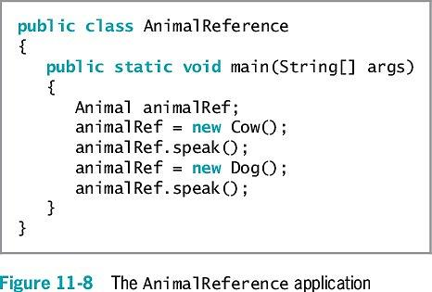
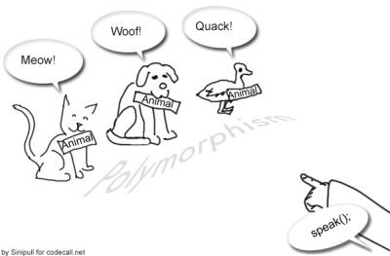
Using Dynamic Method Binding

Slide 8
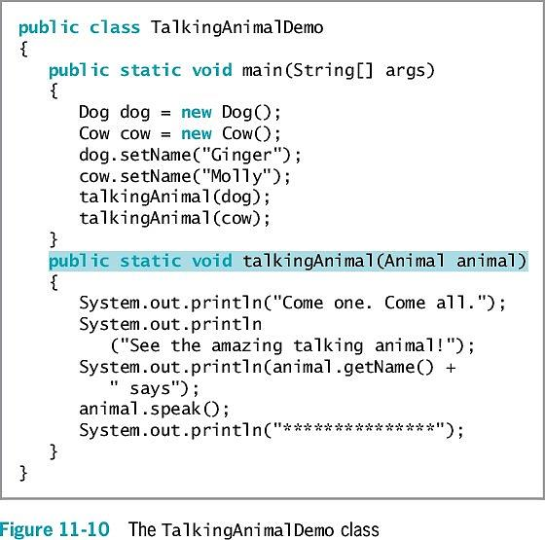
Using a Superclass as a Method Parameter Type
Useful when you want to create a method that has one or more parameters that might be one of several types
Use dynamic method binding
public static void talkingAnimal(Animal animal)
Dog dog = new Dog();
talkingAnimal(dog);
What will the program on your right output?

Slide 9
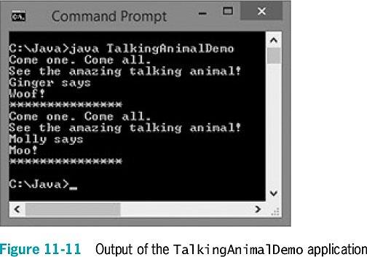
Using a Superclass as a Method Parameter Type

Slide 10
Creating Arrays of Subclass Objects
Create a superclass reference
Treat subclass objects as superclass objects
Create an array of different objects that share the same ancestry
Create an array of three Animal references
Animal[] animalRef = new Animal[3];
Reserve memory for three Animal object references

Slide 11
Exercise
Create an abstract NewspaperSubscription class with fields for the subscriber name, address and rate. Include get and set methods for the name field and get methods for the address and subscription rate; the setAddress() method is abstract.
Create two subclasses named PhysicalNewspaperSubscription and OnlineNewspaperSubscription. The parameter for setAddress() method of the PhysicalNewspaperSubscription class must contain at least one digit; otherwise, and error message is displayed and the subscription rate is set to 0. If the address is valid, the subscription rate is assigned $15. The parameter for the setAddress() method of the OnlienNewspaperSubscription class must contain an at sign (@) or an error message is displayed. If the address is valid, the subscription rate is assigned $9.
Finally, write an application that declares several objects of both subscription subtypes and displays there data fields.

Slide 12
Using the Object Class and Its Methods
Object class
Every Java class is an extension of the Object class
Defined in the java.lang package
Imported automatically
Includes methods to use or override

Slide 13
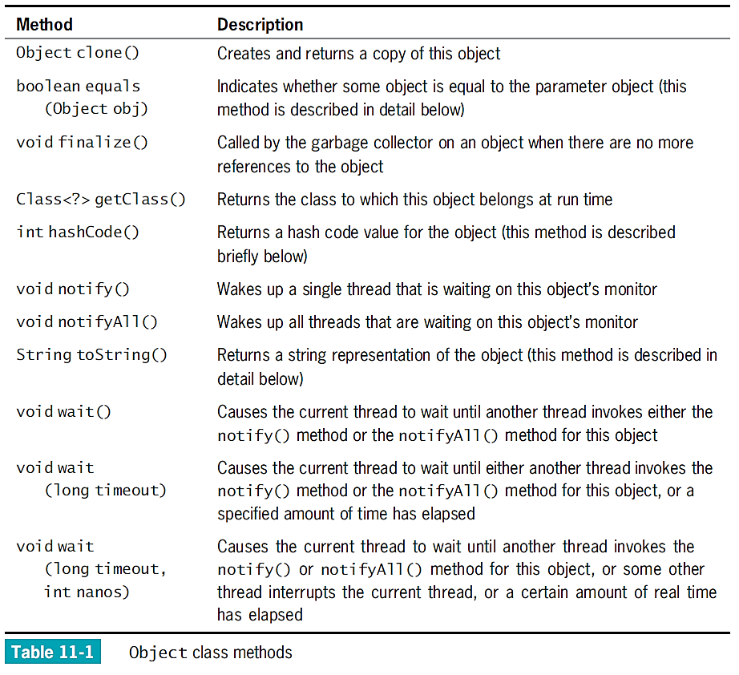

Slide 14
Using the toString() Method
toString() method
Converts an Object into a String
Contains information about the Object
Output:
Class name
@ sign
Hash code
Write an overloaded version of the toString() method
Display some or all data field values for an object
Can be very useful in debugging a program
Display the toString() value
Examine its contents

Slide 15
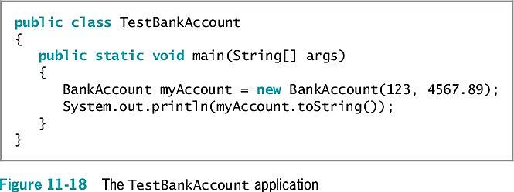
Using the toString() Method

Slide 16
Using the equals() Method
equals() method
Takes a single argument
The same type as the invoking object
Returns a boolean value
Indicates whether objects are equal
Considers two objects of the same class to be equal only if they have the same hash code
Example of the equals() method:
if(someObject.equals (someOtherObjectOfTheSameType))
System.out.println("The objects are equal");
To consider objects to be equal based on contents, you must write your own equals() method

Slide 17
Using the equals() Method
Object method hashCode()
Returns an integer representing the hash code
Whenever you override the equals() method:
You should override the hashCode() method as well
Equal objects should have equal hash codes

Slide 18
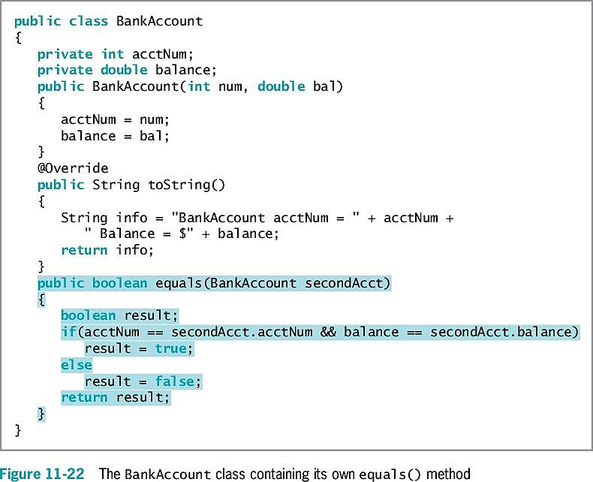

Slide 19
Using Inheritance to Achieve Good Software Design
You can create powerful computer programs more easily if components are used either “as is” or with slight modifications
Makes programming large systems more manageable
Advantages of extendable superclasses
Save development time
Much code is already written
Save testing time
Superclass code is already tested
Programmers understand how a superclass works
A superclass maintains its integrity
The bytecode is not changed

Slide 20
Exercise
The Cullerton Park District holds a mini-Olympics each summer. Create a class named “Participant” with fields for a name, age and street address. Include a constructor that assigns parameter values to each field and a toString() method that returns a String containing all the values. Also include an equals() method that determines two Participants are equal if they have the same values in all three fields.
Create an application with two arrays of at least eight Participants each – one holds Participants in the mini-marathon, and the other holds Participants in the diving competition. Prompt the user for participant values. After the data values are entered, display values for Participants who are in both events.

Slide 21
Creating and Using Interfaces
Multiple inheritance
Inherit from more than one class
Prohibited in Java
Variables and methods in parent classes might have identical names
Creates conflict
Which class should super refer to when a child class has multiple parents?
Interface
An alternative to multiple inheritance
Looks like a class except all of its methods are implicitly public and abstract, and all of its data items are implicitly public, abstract, and final
A description of what a class does
Declares method headers

Slide 22
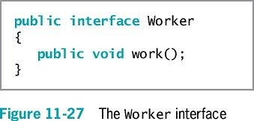
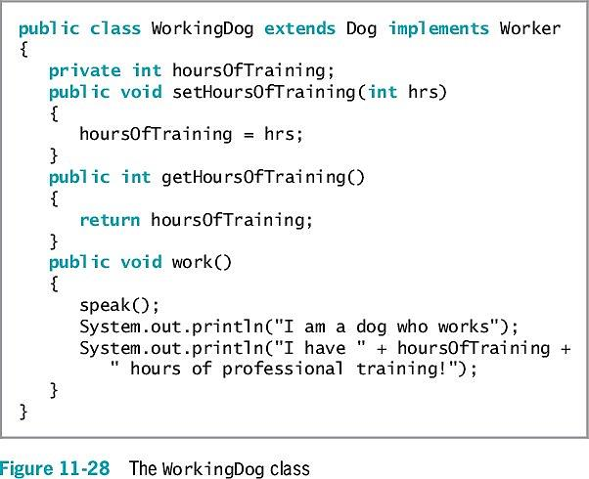
Creating and Using Interfaces

Slide 23
Creating and Using Interfaces
Create an interface
Example: public interface Worker
Implement an interface
Use the keyword implements
Requires the subclass to implement its own version of each method
Use the interface name in the class header
Requires class objects to include code
public class WorkingDog extends Dog implements Worker

Slide 24
Creating and Using Interfaces
Abstract classes versus interfaces
You cannot instantiate concrete objects of either
Abstract classes
Can contain nonabstract methods
Provide data or methods that subclasses can inherit
Subclasses maintain the ability to override inherited methods
Can include methods that contain the actual behavior the object performs
Interfaces
Methods must be abstract
Programmers know what actions to include
Every implementing class defines the behavior that must occur when the method executes
A class can implement behavior from more than one parent

Slide 25
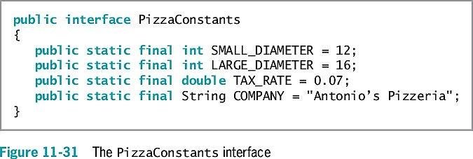
Creating Interfaces to Store Related Constants
Interfaces can contain data fields
Data fields must be public, static, and final
Interfaces contain constants
Provide a set of data that many classes can use without having to redeclare values

Slide 26
Creating and Using Packages
Package
A named collection of classes
Easily imports related classes into new programs
Encourages other programmers to reuse software
Helps avoid naming conflicts or collisions
Gives every package a unique name

Slide 27
Creating and Using Packages
Create classes for others to use
Protect your work
Do not provide users with source code in files with .java extensions
Provide users with compiled files with .class extensions
Include the package statement at the beginning of the class file
Place compiled code into the indicated folder

Slide 28
Creating and Using Packages
Compile the file to place in a package
Use a compiler option with the javac command
The -d option places the generated .class file in a folder
Package-naming convention
Use your Internet domain name in reverse order
Collisions
Class naming conflicts

Slide 29
Creating and Using Packages
Java ARchive (JAR) file
A package or class library is delivered to users as a JAR file
Compresses and stores data
Reduces the size of archived class files
Based on the Zip file format

Slide 30
Don’t Do It
Don’t write a body for an abstract method
Don’t forget to end an abstract method header with a semicolon
Don’t forget to override any abstract methods in any subclasses you derive
Don’t mistakenly overload an abstract method instead of overriding it
Don’t try to instantiate an abstract class object
Don’t forget to override all the methods in an interface that you implement
Don’t use the wildcard format to import multiple classes when creating your own packages

Slide 31
Summary
Abstract class
A class that you create only to extend from, but not to instantiate from
Usually contains abstract methods
Methods with no method statements
Can convert subclass objects to superclass objects
Dynamic method binding
Create a method that has one or more parameters that might be one of several types
Create an array of superclass object references but store subclass instances in it

Slide 32
Summary
Interface
Similar to a class
All methods are implicitly public and abstract
All of its data fields are implicitly public, static, and final
To create a class that uses an interface, include the keyword implements and the interface name in the class header
Place classes in packages
Convention uses Internet domain names in reverse order

Slide 33
Quiz
How do abstract classes differ from other classes?
What is method binding?
How does the java.lang.Object equals() method compare object references?
How many interfaces can a Java class implement?

Slide 34
Exercise
Create an abstract class called GeometricFigure. Each figure includes a height, a width, a figure type and an area. Include an abstract method to determine the area of the figure. Create two subclasses called “Square” and “Triangle”.
Add an interface called SidedObject that contains a method called displaySides(); this method displays the number of sides the object possesses. Modify the GeometricFigure subclass to include the user of the interface to display the number of sides of the figure.
Create an application that demonstrates creating objects of both subclasses and using the displaySides() method.

Slide 35
Homework
Read about Java 8 default method implementations at http://docs.oracle.com/javase/tutorial/java/IandI/defaultmethods.html
How does this new feature impact the Java inheritance model?

